Slide 1
PS1
Computing IV
Dr Subhajit Chakrabarty UMass Lowell

Slide 2
Your task is to write a program Sierpinski.cpp with a recursive function sierpinski() and a main() function that calls the recursive function once, and plots the result using standard drawing.
The sierpinski() should draw one filled equilateral triangle (pointed downwards) and then call itself recursively 3 times (with an appropriate stopping condition).
When writing your program, exercise modular design: include a (non-recursive) function filledTriangle() that draws a filled equilateral triangle of a specified size at a specified location.

Slide 3
Your program shall take one integer command-line argument N, to control the depth of the recursion.
All of the drawing should fit snugly inside the equilateral triangle with endpoints (0, 0), (1, 0), and (1/2, √3/2). Do not change the scale of the drawing window.
First, make sure that your program draws a single filled equilateral triangle when N equals 1. Then, check that it draws four filled equilateral triangles when N equals 2.
We can think of the unit Sierpinski triangle as comprising 3 Sierpinski triangles, each of side length 1/2.

Slide 4
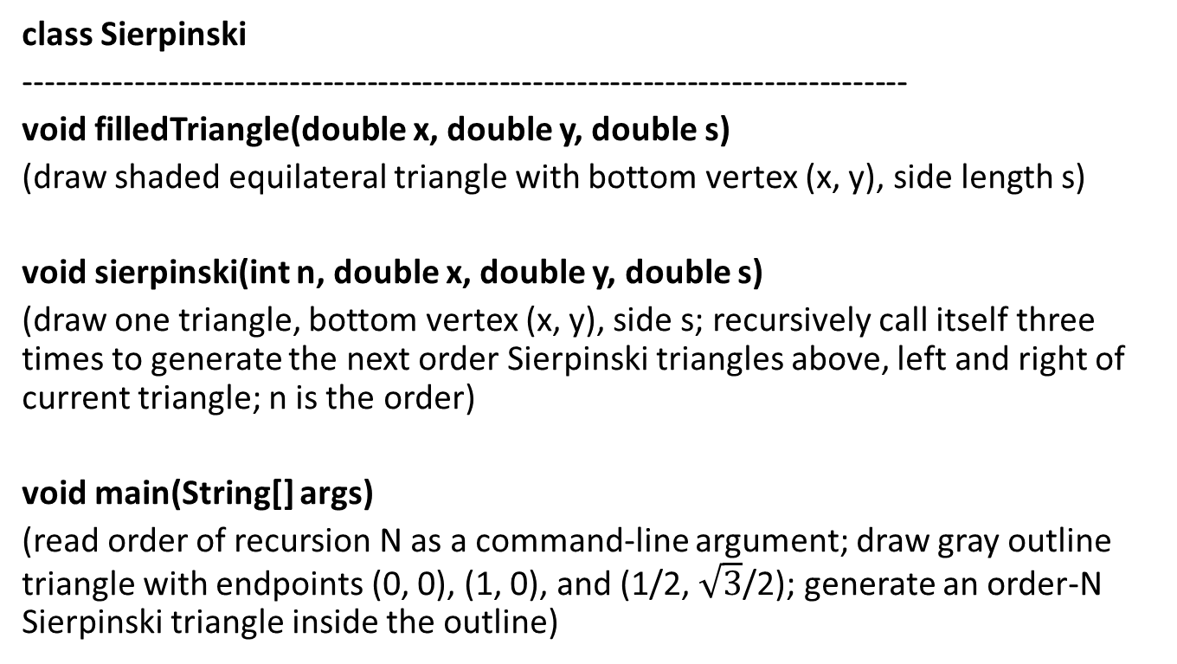
class Sierpinski
--------------------------------------------------------------------------------
void filledTriangle(double x, double y, double s)
(draw shaded equilateral triangle with bottom vertex (x, y), side length s)
void sierpinski(int n, double x, double y, double s)
(draw one triangle, bottom vertex (x, y), side s; recursively call itself three times to generate the next order Sierpinski triangles above, left and right of current triangle; n is the order)
void main(String[] args)
(read order of recursion N as a command-line argument; draw gray outline triangle with endpoints (0, 0), (1, 0), and (1/2, $\sqrt{3}$/2); generate an order-N Sierpinski triangle inside the outline)

Slide 5
Nth Fibonacci: Iterative
int fib(int n)
{
int a = 0, b = 1, c, i;
if (n == 0)
return a;
for (i = 2; i <= n; i++)
{
c = a + b;
a = b;
b = c;
}
return b;
}

Slide 6
Nth Fibonacci: Tail recursive
int fib(int n, int a = 0, int b = 1)
{
if (n == 0)
return a;
if (n == 1)
return b;
return fib(n - 1, b, a + b);
}

Slide 7
Makefile
Make enables the end user to build and install your package without knowing the details of how that is done -- because these details are recorded in the makefile.
Make figures out automatically which files it needs to update, based on which source files have changed.
Make is not limited to any particular language.

Slide 8
A rule in the makefile tells Make how to execute a series of commands in order to build a target file from source files. It also specifies a list of dependencies of the target file. This list should include all files (whether source files or other targets) which are used as inputs to the commands in the rule.
target: dependencies ...
commands
...

Slide 9
Session for setup issues

